Slide 1
Air Quality Workshop

Slide 2
What gases are in the air in Lewisham?

Slide 3
What gases are in the air in Lewisham?
Kr
SO2
O2
CO2
O3
I
CO
N
NO2
Ar
NH3
Xe
He
CH4
H
N2O
Notes:
These are the chemical formulas for the gases that make up the air that we breathe.
There are lots of different gases in our air, some that you might recognise and some not.
Which ones do you recognise?

Slide 4
What gases are in the air in Lewisham?
O2
O2
CO2
Oxygen
Carbon Dioxide
N
Nitrogen
He
CH4
H
Helium
Methane
Hydrogen
Notes:
You might be a bit more familiar with these gases.
Which of these gases makes up most of the air we breathe in?

Slide 5
What gas makes up most of the air?
Argon
1%
Oxygen
21%
Carbon Dioxide 0.04%
Helium 0.0005%
Methane 0.0002%
Hydrogen 0.0001%
Nitrogen
78%
8
Notes:
We often hear a lot more about oxygen in our air because it is the gas that we need to breathe.
You might be surprised that nitrogen makes up such a large amount of our atmosphere.
Nitrogen is an essential nutrient for sustaining life on Earth- plants need an adequate annual supply for proper growth and productivity.

Slide 6
Why do we care about what is in the air?
Activity:
Jog on the spot for one minute – set a timer.
Notes:
‘Why do we need safe, clean air?’ Ask children to jog on the spot for one minute – set a timer.
Ask them what they notice about their breathing.
Why is it faster?
Why is it important that the air we breathe is clean?

Slide 7
Why do we care about what is in the air?
Whatever is in the air will enter our bodies through our mouth, nose and eyes.
If there are things in the air that should not be there, this could make us feel uncomfortable or ill.
Notes:
Why do we care about what is in the air?
We have to breathe in oxygen in the air in order to breathe through our nose and mouth. When we do this, we inhale other particles within the air.
What happens if there are things in the air that should not be there? What do we call it?

Slide 8
What is air pollution?
The presence of things into the air that are harmful to human health and the environment.
It is world’s largest single environmental health risk.
Even gases that are not usually considered bad, like carbon dioxide, can be pollution if there is too much of them.
Notes:
We call it pollution
Pollution is the presence of things in the air that are harmful to human health and the environment
If there is more carbon dioxide in the air than there should be, this is pollution

Slide 9
What is air pollution?
PM10
Gases
PM2
Particulates
Liquid and solid particles in the air
Notes:
Pollution can come in two forms
We have already spoken about gases but what about particulates?
Particulates are little particles of stuff floating through the air, like dust
Particulates can be 10x or 40x smaller than a grain of sand
PM10 = less than 10 micrometres
PM2.5 = less than 2.5 micrometres
Which of these sizes is more dangerous? Why?
PM2.5 – they get into your bloodstream and other organs around your body

Slide 10
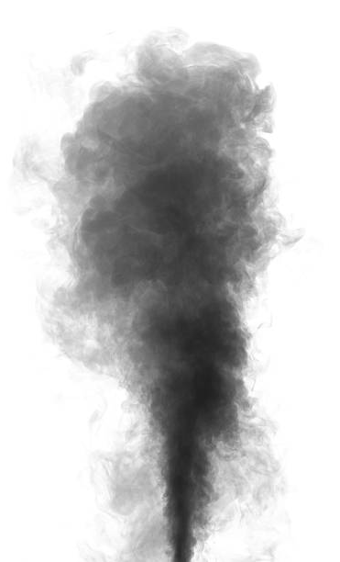
What are some examples of polluting particulates in Lewisham?
Soot
Smoke
Pollen
Dust
Black powdery substance, often comes from burning coal or wood
Comes from burning materials, made up of carbon dioxide and soot
Powdery substance produced by plants
Fine particles of solid matter such as soil
Notes:
Can you think of some examples of particulates that pollute the air?

Slide 11
What gases are in the air?
Kr
SO2
O2
CO2
O3
I
CO
N
NO2
Ar
NH3
Xe
He
CH4
H
N2O
Notes:
Back to the gases that make up the air we breathe.
The makeup of the air is a perfect balance for us to live
Gases like Oxygen, Carbon Dioxide and Nitrogen are key to our life on earth
But, it is when there are too much of any of these gases that is bad for us

Slide 12
What gases are pollutants?
Sulphur Dioxide
SO2
O2
Carbon Dioxide
CO2
O3
N
I
CO
Ground-level ozone
Carbon Monoxide
NO2
Nitrogen Dioxide
Methane
CH4
N2O
Nitrous Oxide
Notes:
When there is too much of these gases, they are pollutants
These are the main pollutant gases

Slide 13
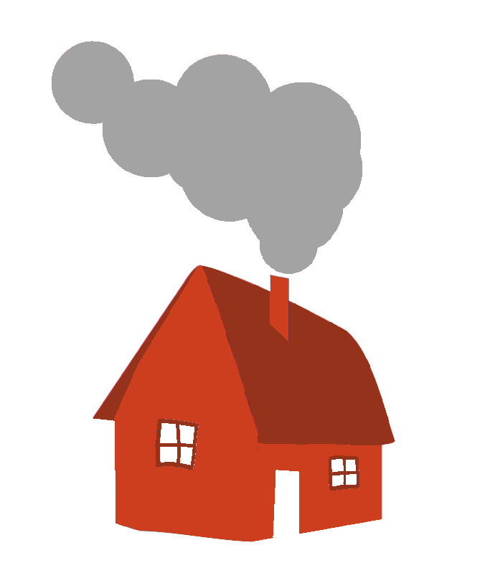
Which of these creates the most pollution in London?
Factories and power stations
Fireplaces and gas hobs in homes
Road vehicles
Trains and tubes
Farming
Shipping
Construction
Air travel
Notes:
Human actions can cause pollutant gases.
Here are a few ways.

Slide 14
Which of these creates the most pollution in London?
2.6 million privately owned vehicles
in London
Road vehicles
Notes:
Which of these creates the most pollution in London?
Cars!
2.6 million privately owned vehicles in London
You might be surprised that cars are higher than planes or factories
Cars v planes
There are many more cars than planes
People use cars more than planes
Unless they are fully occupied, per person cars can create as much pollution as planes over long distances
Cars v factories
One factory will produce more pollution than one car
But there are so many cars in London that overall they produce more pollution

Slide 15
Which of these creates 17% of particulate matter pollution in London?
Fireplaces and gas hobs in homes
Notes:
Which of these creates 17% of particulate matter pollution in London?
Fireplaces, from wood/ coal burning in homes, and cooking on gas hobs

Slide 16
How do cars create particulate pollution?
Exhaust pipe
Brake pads
Tyres
Road
Notes:
How do cars create particulate pollution?
What is the force between the wheels and the car?
Friction!
Little bits of stuff come off the wheels and the road when they are in contact, as well as brake pads when cars slow down, and this is released into the atmosphere
Soot and smoke that comes out of the exhaust pipe contains particulate matter

Slide 17
How is Nitrogen Dioxide created in a car?
N O2
Nitrogen
Oxygen
Notes:
What is Nitrogen Dioxide? What two gases come together to make it?
Oxygen
Nitrogen
Nitrogen Dioxide is one of the most dangerous gases as human activities produce a lot of it and it is very damaging for our body
A lot of air quality discussion focuses on Nitrogen Dioxide and particulate matter levels
Humans increase the levels of nitrogen dioxide in the atmosphere

Slide 18
How is Nitrogen Dioxide created in a car?
Fuel is burned and the engine gets very hot
?
Nitrogen (N) and Oxygen (O2) bind together in this hot engine
Nitrogen Dioxide (NO2) and soot particles are released from the exhaust pipe
Notes:
How is nitrogen dioxide created in a car?
Nitrogen and oxygen react together in a very hot environment – where in the car might that be?
The engine
The Nitrogen Dioxide is then released from the exhaust pipe, along with soot particles created from burning the fuel
Burning diesel creates more of this nitrogen dioxide than burning petrol
People used to think that diesel engines were better, because they created less carbon dioxide

Slide 19
Engine Idling
What does idling mean?
Leaving an engine running after a vehicle has been stationary for more than 30 seconds
150 balloons of pollution is released by an idling car per minute
Why might someone idle?
Charging phone
Listening to music
Waiting for someone
Heating/air conditioning
Parked illegally
Notes:
What is engine idling?
Engine idling is when the vehicles engine is running after a vehicle has been stationary for more than 30 seconds
Why might someone idle?
Charging phone
Listening to music
Waiting for someone
Heating/air conditioning
Parked illegally
Why is engine idling so bad?
150 balloons of pollution is released by an idling car per minute

Slide 20
How can we tell when somewhere is polluted?
See some smoke, itchy eyes
Measurements
Bad smell
NO2
Forecasts and
warnings
Bad taste, coughing
Notes:
How can we tell when somewhere is polluted?
You can often smell it
You might be able to taste it
Our eyes might be painful
It might be harder to brethe
You can measure if someone is polluted:
Measuring pollutant limits over time, e.g. in diffusion tubes that collect pollutant
Download air text which alerts you about forecasts for air quality in your area, or alerts you of warnings for changes in air quality

Slide 21
Monitoring air pollution
Government policy- minimum and maximum air pollution limits
Air pollution monitoring helps to achieve this.
Over 147 diffusion monitoring locations and 5 sensor monitoring sites in Lewisham!
Diffusion tube(measures NO2)
Sensor
(measures a range of gases and particulates)
Notes:
We measure air pollution to determine if it is increasing, and direct what we might need to do to reduce air pollution.
In the UK, the government set limits on this.
There are many ways that we can do this.
Diffusion tubes are one way to monitor air pollution.
In Lewisham there are 50 diffusion monitoring locations across London.
Tubes are attached in a vertical position (like the image) to a lamppost, road sign, railing etc. The material of the tubes means that air can flow through the tube and detects the amount of nitrogen dioxide in the air. They are sent collected after 2-4 weeks and a scientist analyses the results.
Sensor are another way- these measure real time data. Air passes through the sensor and it measures particulates and gases in the air. The data is stored and can be downloaded from a computer. These are much more expensive.

Slide 22
What can pollution do to our body?
Irritation and infections
Asthma
Reduced lung capacity
Lung cancer
Heart disease
Higher blood pressure
Abnormal heart rhythms
Reduced attention span
Anxiety
Headaches
Notes:
What can pollution do to body?
Lungs?
Heart?
Brain?

Slide 23
Asthma
Symptoms
Wheezing
Breathlessness
Tight chest
Coughing
These symptoms can get worse for a short time and this is called an asthma attack.
Notes:
Hands up if you have asthma here… yes it’s very common! Asthma is the inflammation and sensitivity of airways that become narrow and clogged with mucus in response to certain triggers.
One of these triggers can be pollution.
Other causes can be genetics, if your parents have it or if you have other allergy related conditions such as hayfever or food allergies.

Slide 24
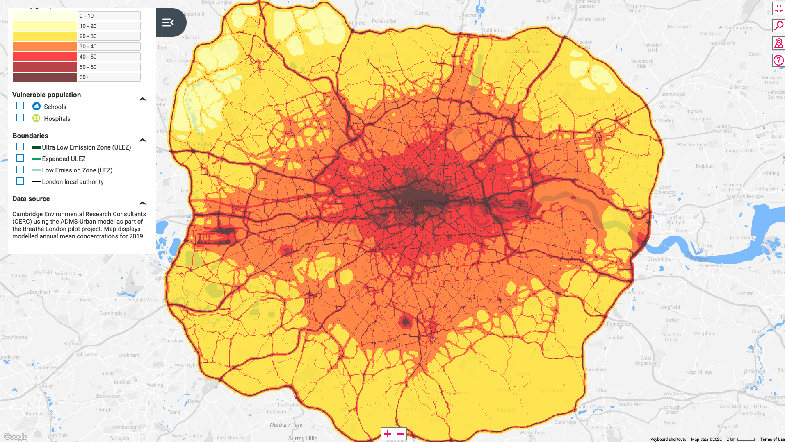
Where is pollution worst?
M25
North Circular
Legal limit
NO2 Concentration in London in 2019 in micrograms per metre cubed (µg m³)
Lewisham
Heathrow Airport
Notes:
Where is this a map of and what is it mapping?
London
NO2
Where is NO2 highest and lowest on the map?
Highest in darker part, Central London
Lowest in lighter part, Outer London
What are the dark lines?
Roads have the highest pollution in London
What are the circular lines the arrows are pointing to?
North circular
What is the circled dark area on the left?
Heathrow airport
Where are we on this map?

Slide 25
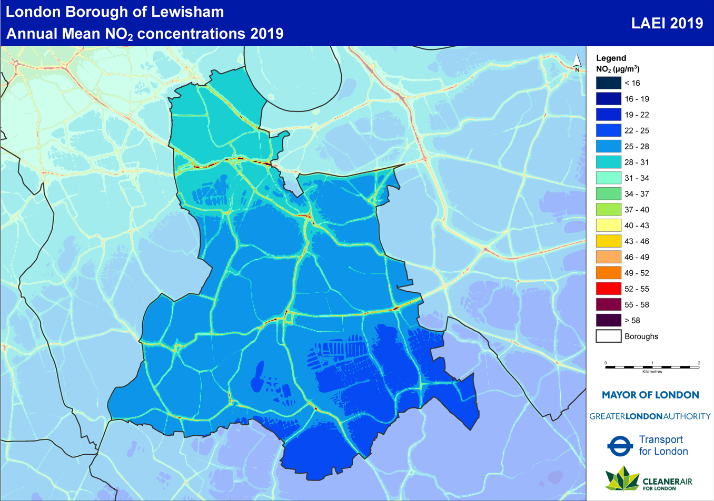
Air pollution in Lewisham
Notes:
Within Lewisham there are areas that have worse air pollution
Where is air quality worse in Lewisham?
Around roads

Slide 26
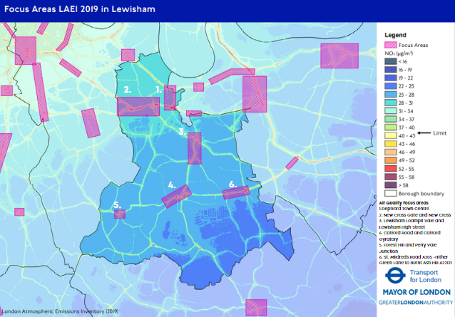
Focus areas in Lewisham
Notes:
These show the focus areas in Lewisham. Focus areas fall around roads.

Slide 27
Indoor Air pollution
Air pollution can be indoors and outdoors…
Indoor air is often more polluted than outdoor air due to the wide range of indoor pollutants and limited air flow.
Cooking- releases gases and particles when using cooking equipment such as oven/ stove.
Chemicals in cleaning products or craft materials, that are released into the air.
Personal cleaning products such as shower gels, perfumes also release harmful chemicals similar to cleaning products.
Dust, mold and bacteria can cause pollution
Notes:
Air pollution can be indoors and outdoor and is often higher than pollution outdoors due to a higher concentration of pollution in confined indoor spaces, and reduced air flow.
There are different things that we use within our home that can cause pollution:
Cooking materials
Cleaning products
Personal cleaning products
Dust, mould, damp, bacteria
Impacts of indoor air pollution are the same as outdoor pollution mentioned earlier. Who can remember what these are?

Slide 28
Regular servicing and sweeping of stoves
Walk or cycle to school
Share lifts to school
Lewisham Air Quality Accreditation Scheme
Raise awareness
“Ready to burn”
wood
How do we reduce air pollution and our exposure to it?
Ask people to stop idling
Modern wood burning stoves
Park and stride
Walk on building-side of pavement
Idling Action Pledge
Use electric cars
Download
Lewisham Air app
Plant hedges
Walk a quieter route
Notes:
What can we do as a school to reduce air pollution and our exposure to it?
These are all initiatives that Lewisham council have helped to set up, or that we can do very easily.

Slide 29
Activity
Write a formal letter to the Mayor of London, outlining the main causes and effects of air pollution, and persuading him to implement the strongest solutions
NO2
Notes:
Ask the children to write a formal letter to the Mayor of London, outlining the main causes and effects of air pollution, and persuading him to implement the solutions.
Some children could use the template “I need clean air because I like...” to draw a poster, showing the things they do in their lives that are affected by air pollution.
Petition posters can be made.

